Slide 1
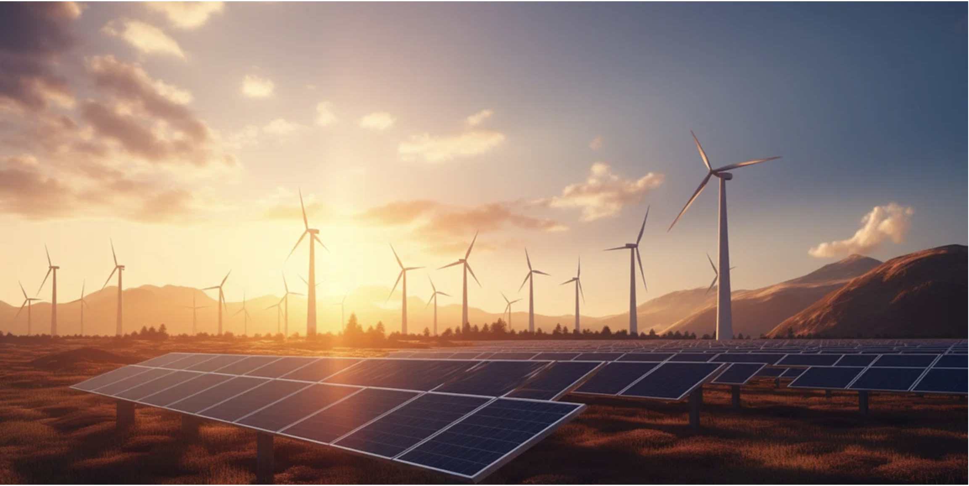





3rd & 4th Project Progress Meeting 22 April 2024
Destination Renewable Energy (DRE) Use Case
Selected by RHEA under the ESA regulations and Best Practice processes

Slide 2
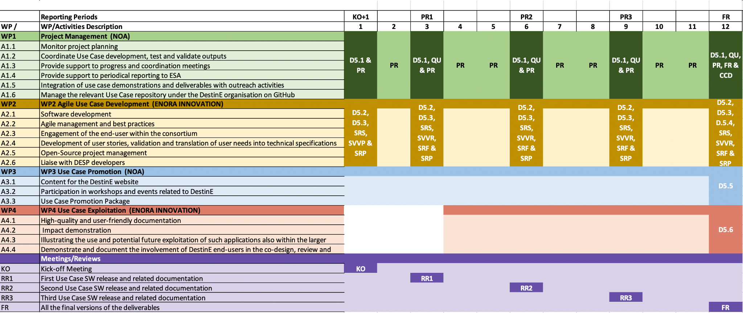
Gantt chart
13/11/2023
16/02/2024
22/05/2024
27/08/2024
20/11/2024
15/12
19/01
15/03
19/04
21/06
19/07
25/09
23/10
Notes:
Gantt chart has not changed, we just added the planned dates for the entire course of the project, on top based on today’s KO.

Slide 3
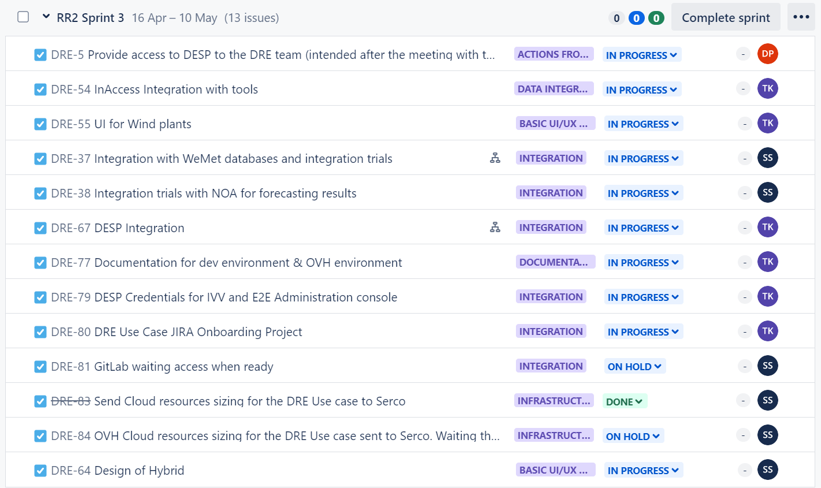
Release 2 - Sprint 3 JIRA view
(April 16th 2024 to May 10th 2024)

Slide 4
Release 2 - Sprint 2 Goal
(March 18th 2024 to April 12th 2024)
DESP Integration task: A session took place on Friday March 22nd, first option CI/CD is preferred
IAM Integration is in progress
Integration trials with WeMet for forecasting results
Focusing on integration process for the wind results and their presentation on HYREF
Preprocessing of the provided data for the SW
Integration trials: Data collection API with Quest production sites
Work is done or is in progress under below areas
UI Wind design
DESP Integration task
Documentation for coding and environments (dev/OVH)
Wireframe designed to cover the business need to contribute to the scalability of the use Case until DESP services are published
Design of Hybrid

Slide 5
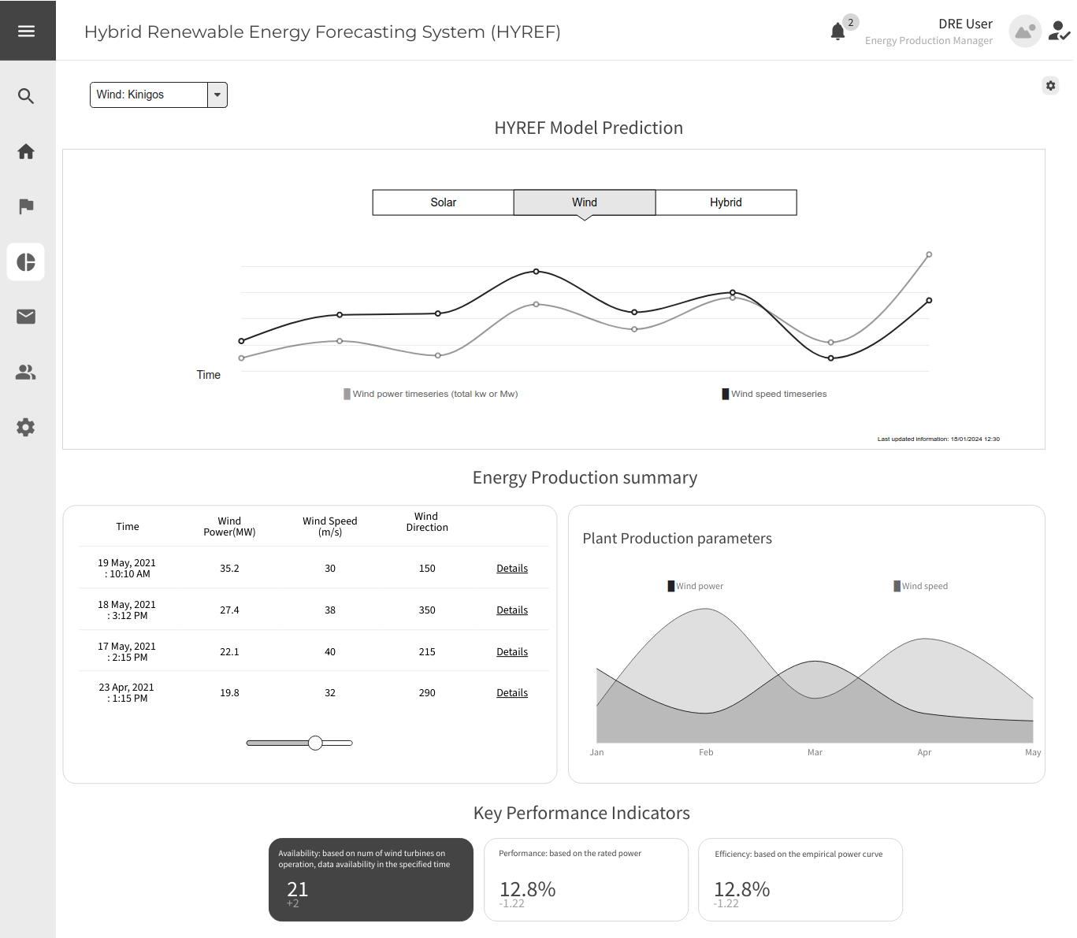
UI for Wind

Slide 6
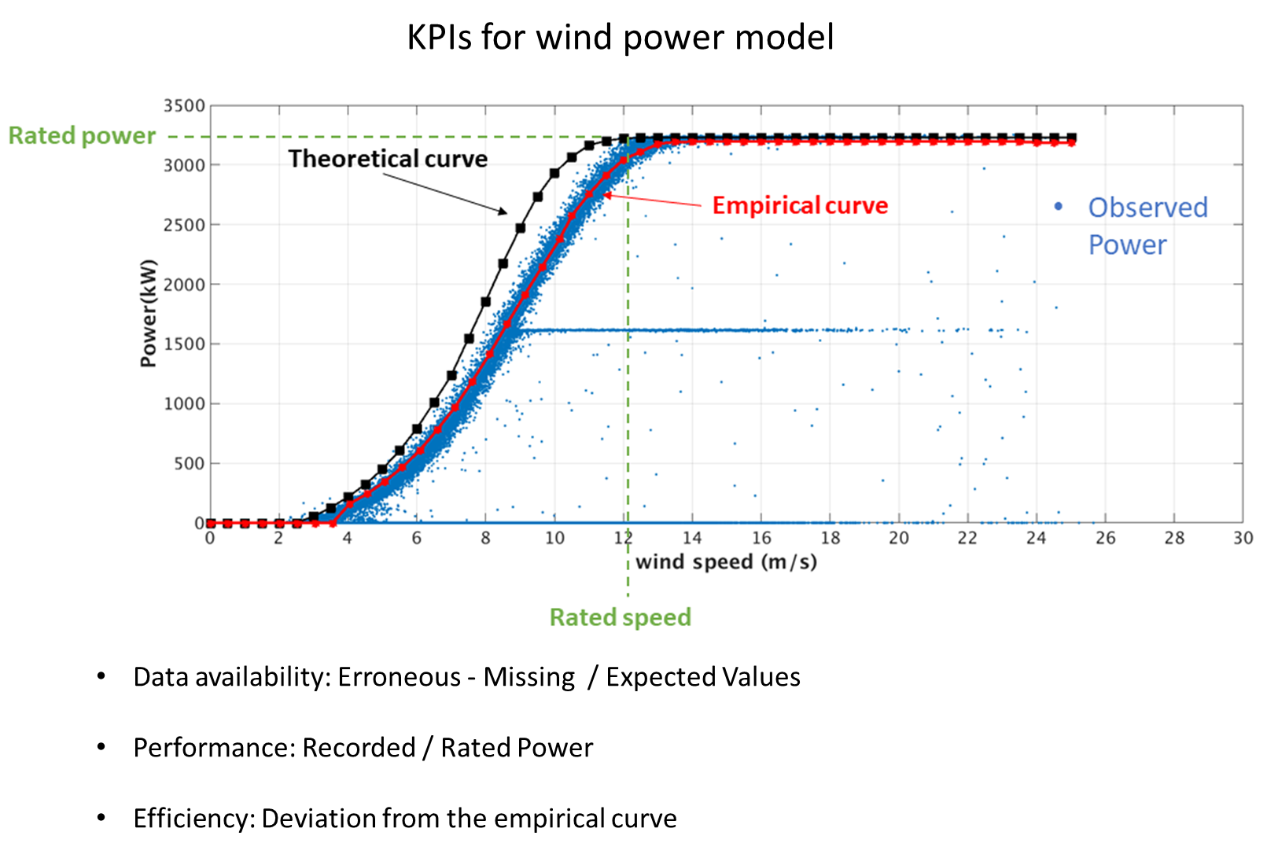

Slide 7
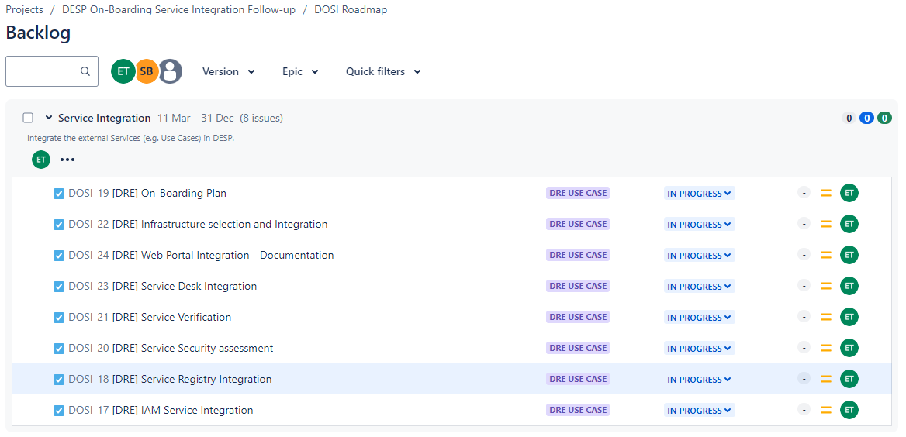
Onboarding
DESP Integration task: A session took place on Friday March 22nd, first option CI/CD is preferred
IAM Integration is in progress
DESP Credentials for IVV and E2E Administration console
OVH Cloud resources sizing for the DRE Use case sent to Serco. Waiting the access
GitLab waiting access when ready
Working on documentation for dev environment & OVH environment
Update DRE Use Case JIRA Onboarding Project

Slide 8
Summary of outreach activities – KO+5
Regarding IGARSS and EGU 2024:
Poster presented during EGU 2024
IGARSS: Paper #1219: Destination Renewable Energy: A Renewable Energy application based on Destination Earth Initiative data and platforms (CCS.28: Copernicus and Destine Platform Ecosystem Opportunities): Accepted. Oral presentation to be prepared.
Notes:
Do you have any updates regarding the ESA-NASA meeting that you could share with us? Any questions or comments related to the DRE Use Case?

Slide 9
Thank you!

